Slide 1
Diabetes Risk Detector App
A Machine Learning-Powered Tool for detecting Diabetes Risk
PRESENTED BY
Farwa Khalid
ATS INTERNSHIP
SUMMER 2024

Slide 2
Why I Joined the ATS Internship? Learning, Growing, and Making an Impact.
I joined the ATS Internship in Summer 2024 to gain real-world experience and learn from experts in the field. I wanted to improve my skills and work on meaningful projects like the Diabetes Risk Detector App. This internship gave me the chance to apply what I’ve learned, work with others, and make a positive impact through technology.
Motivation Behind the Diabetes Risk Detector App
The Diabetes Risk Detector App is designed to help people easily check their risk of diabetes. Diabetes is a growing health concern, and early detection can prevent serious problems. This app uses smart technology to analyze health information and provide quick, personalized feedback. It's easy for anyone to use, making health awareness more accessible and encouraging people to take care of their health before any issues arise.

Slide 3
Overview of the Diabetes Risk detector App
This app helps users detect their risk of diabetes based on various health indicators. Users enter information about their health habits and conditions, such as blood pressure, cholesterol levels, BMI, and lifestyle factors. After submitting their details, the app uses a trained machine learning model to analyze the data and provide a detection of whether they are at risk of diabetes or not. The results are displayed along with the probability of the detection, making it easy for users to understand their risk level.
You can explore the Diabetes Risk Detector App by visiting the following link:
https://projectadiabetesdetection-see.streamlit.app

Slide 4
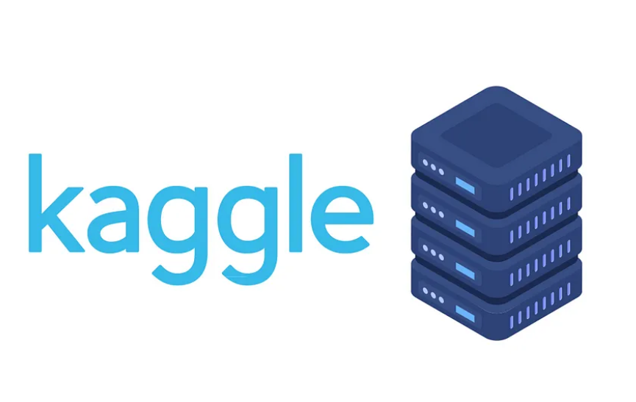





Project Workflow
Data Exploration, Feature Engineering, and Model Development
Dataset
Model: Neural Network
+
Streamlit Server Deployment
+
Uploded
User Interface (UI) Development

Slide 5
DEMO

Slide 6
Thank you!
Thank you for your time and attention. If you have any questions or need further information about the Diabetes Risk Detector App, feel free to ask. I'm happy to provide more details or discuss any aspect of the app.

